Slide 1

Heart Attack Prediction

Slide 2
Introduction
One person dies every 34 seconds in the United States from cardiovascular disease.
Heart disease cost the United States about $229 billion each year from 2017 to 2018.

Slide 3

Problem Understanding
In this project, we are building the predictive machine learning model which can predict whether a patient have chance getting heart attack.
Doctors and research analysts can use this model as precautionary measures for their patient and provide appropriate treatments and actions.

Slide 4

Data Understanding
We have downloaded the data from Kaggle website
Our data consists of various attributes which explains about whether a patient have chance of getting cardiac arrest.
We have data columns namely,

Slide 5

Data Attributes in the dataset

Slide 6


Tools Used
Python Programming Language: Python is a most powerful tool which can be used for predictive analysis. It makes developers job easy because of easy syntax and interpreter.
Jupyter Notebook: Jupyter Notebooks which is part of Anaconda software is an integrated development environment for python coding. It provides easy user interface and better reliability while programming.
We are used Python libraries in analysis, which are described in next slide

Slide 7

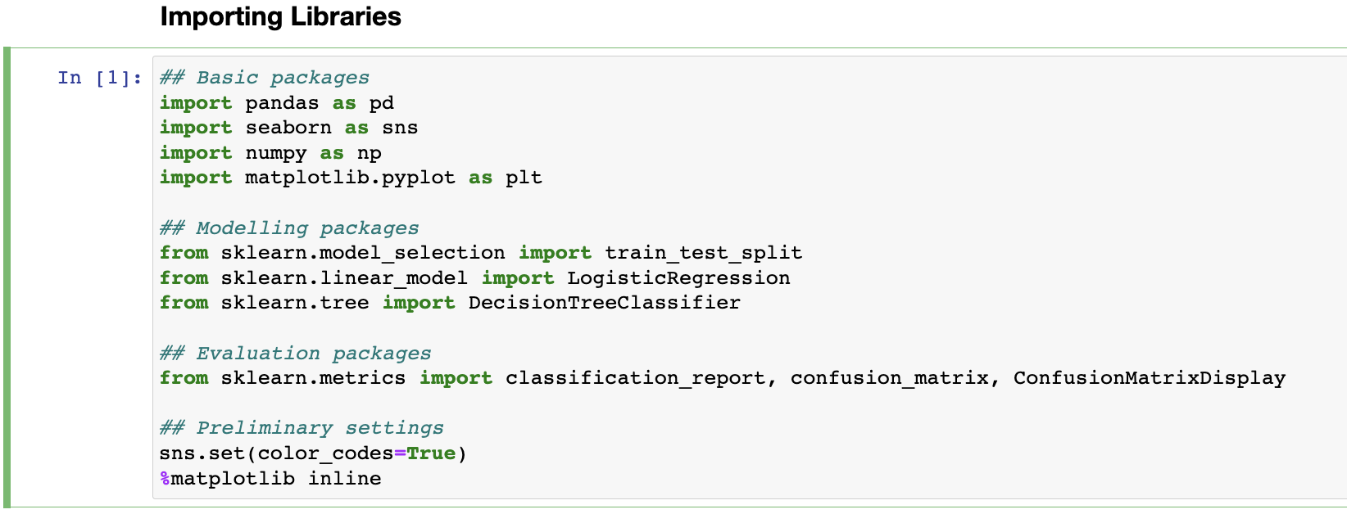
Importing required libraries
We are importing libraries like,
Pandas, Numpy for data handling
Matplotlib and Seaborn for data visualization
Logistic Regression and Decision Tree algorithms for predictions
Classification Report, Confusion Matrix and Confusion Matrix Display for evaluating the models

Slide 8

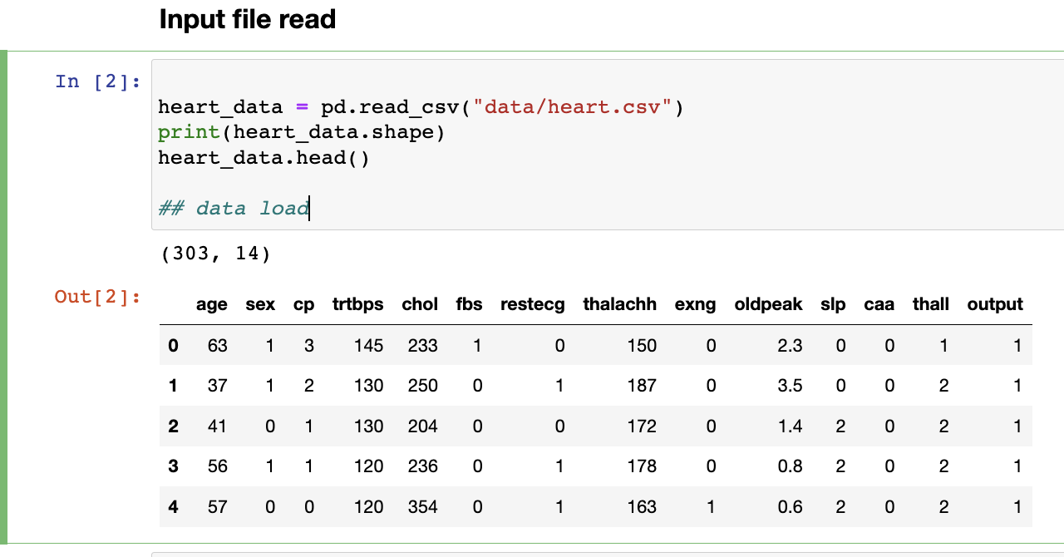
Data Load
We have used the data downloaded from Kaggle
We are using pandas library to read data from csv file.
Using shape attribute we can understand the size of data
Using head() we can see rows in data. Default row count is 5.

Slide 9

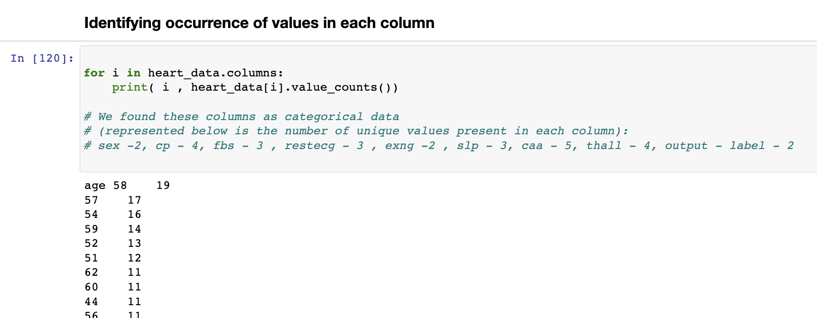
Data Preprocessing
Preprocessing is important step predictive modelling
We are understanding the occurrence of data each variable
There are 8 qualitative variables

Slide 10
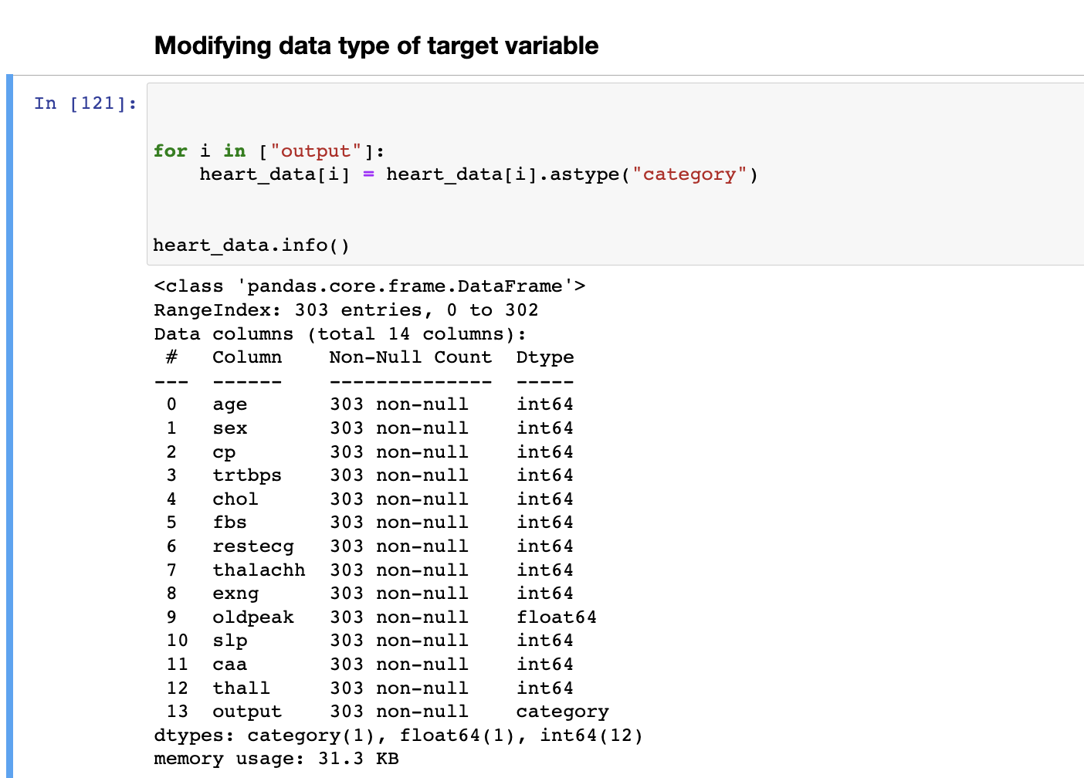
Data Preprocessing
We are modifying the data type of target variable named “output”
Using info() function, we can see not null entries and data type

Slide 11
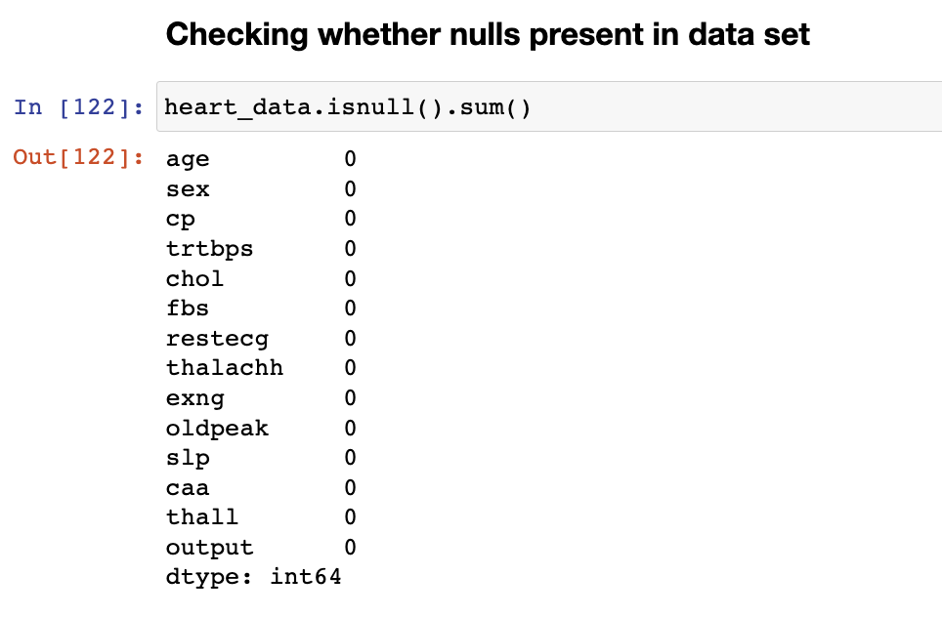
Data Preprocessing
We are checking null values in each column of the data.
We can observe there are no null values in the data

Slide 12
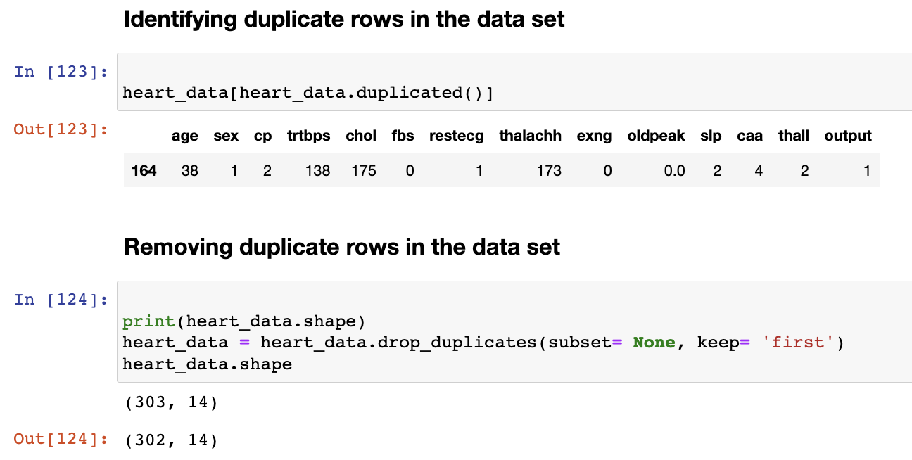
Data Preprocessing
In this step, we are checking for duplicates in the data. Duplicate records may mislead the results
We found 1 duplicate record
In the next step, we are dropping duplicate record

Slide 13

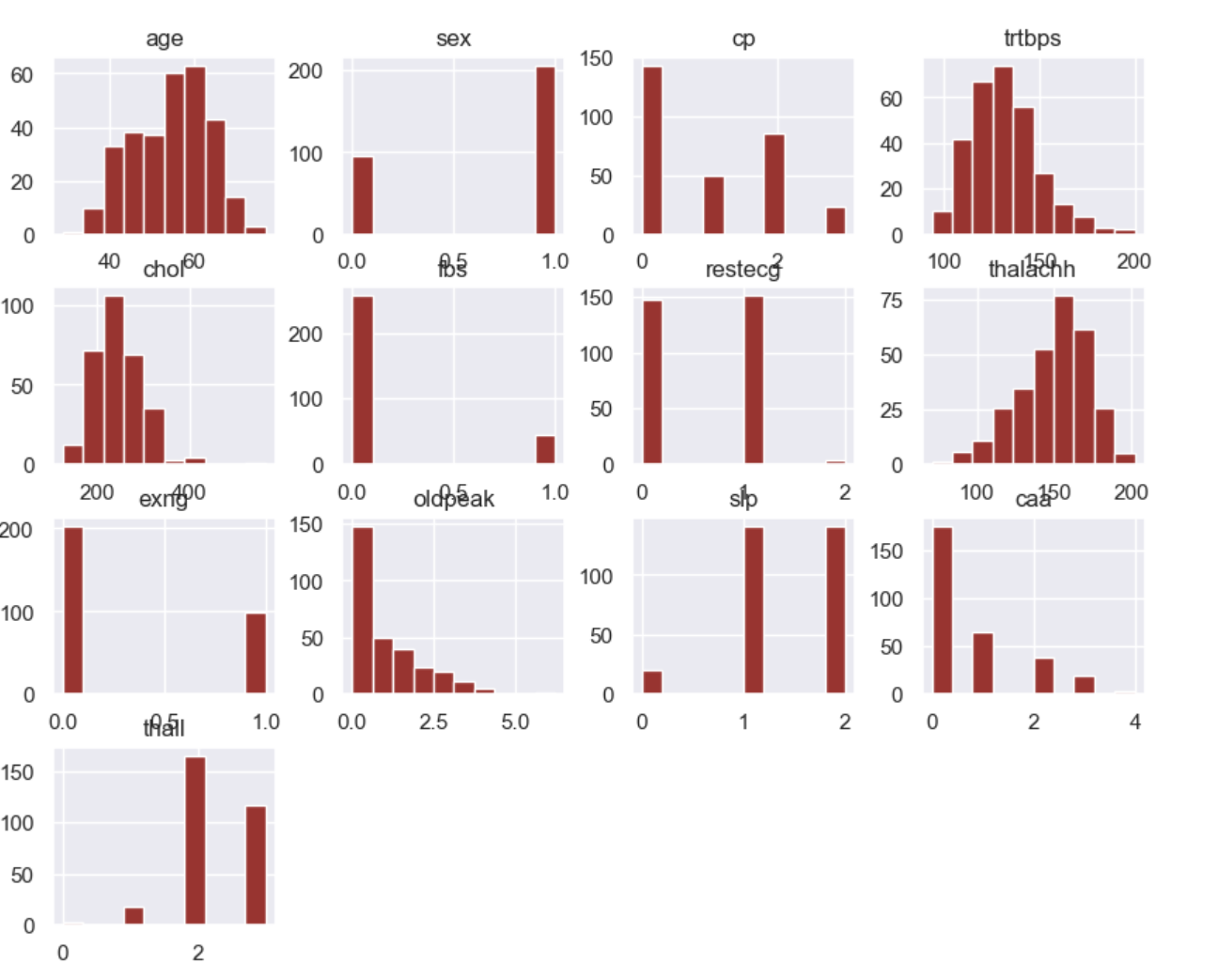
Exploratory Data Analysis
We are plotting histograms for each column in the data
These histograms tell about column distribution in the data set
We can see charts individually for each column in the data set

Slide 14
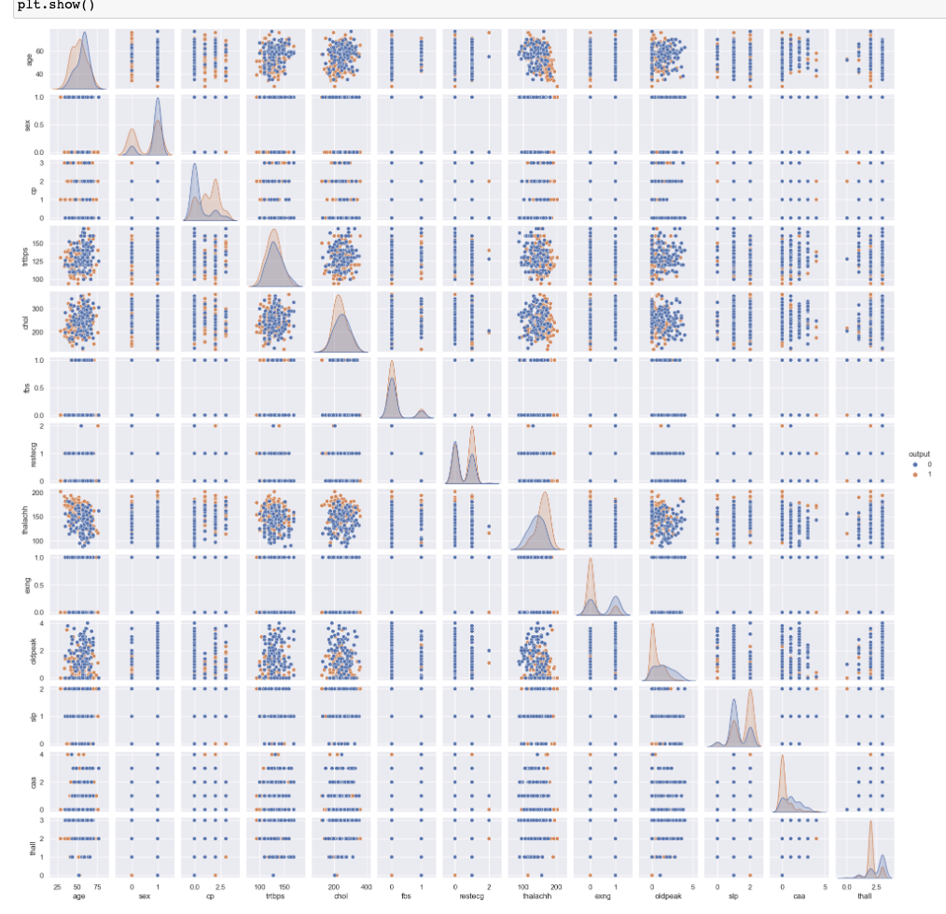
Exploratory Data Analysis
We have plotted scatter matrix to see relationship between the columns.
This plot can be used to draw conclusions whether any redundant columns present in the dataset.

Slide 15
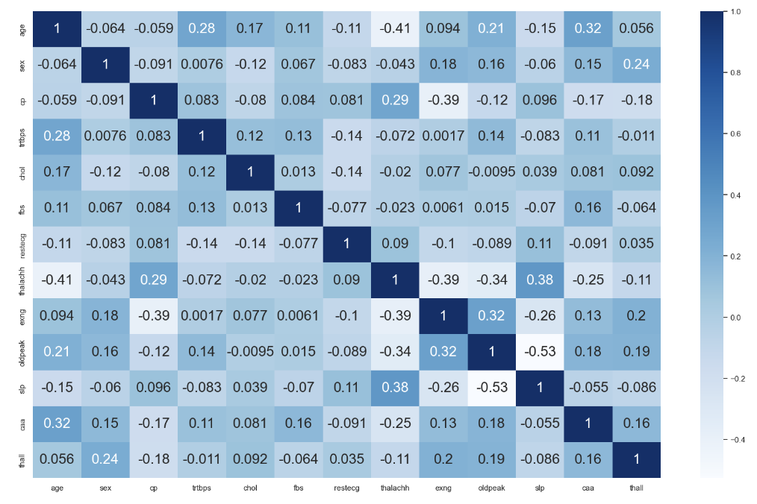
Exploratory Data Analysis
Here, we plot correlation matrix plot and see which columns are correlated with each other in the data set
Correlation matrix plot is helpful to interpret co-efficients between any 2 columns

Slide 16
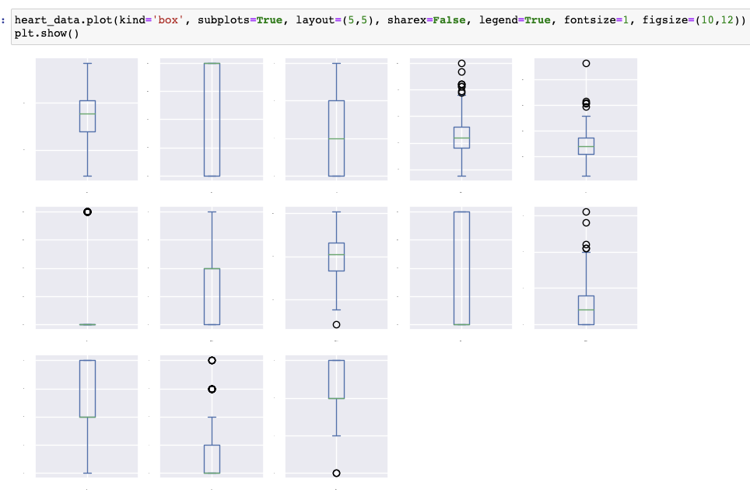
Exploratory Data Analysis
A box plot is drawn for the data to see whether there are any outliers in the data
We found outliers in the data. In the next step we will be removing them.
We removed outliers only for the nominal columns of the dataset

Slide 17
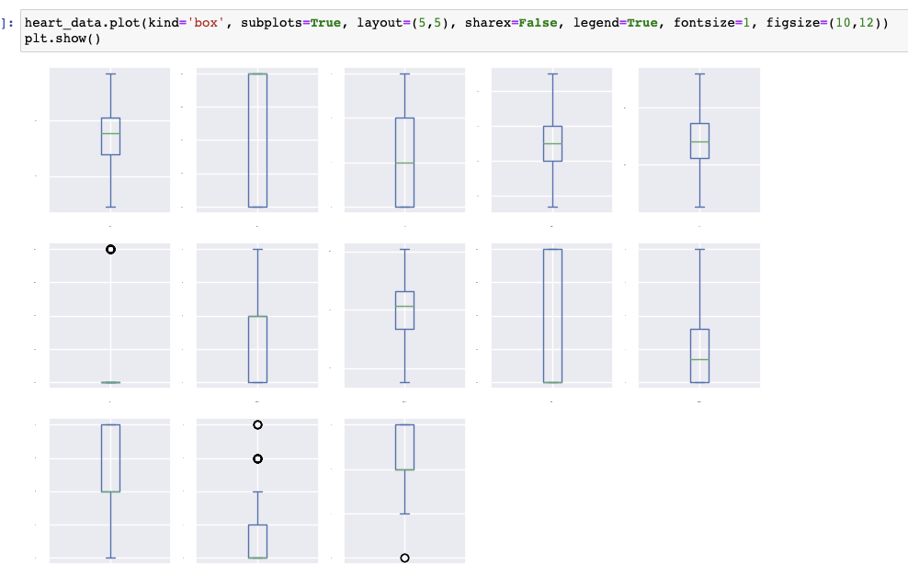
Exploratory Data Analysis
We can see box plot in this slide, there are no outliers now.
We removed outliers which are outside Inter Quartile Range (IQR)
We can ignore outliers for qualitative columns

Slide 18

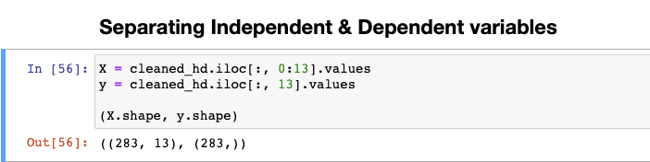
Separating independent and dependent variable
We are dividing the data in to independent and dependent subsets,
We have chosen all columns except output as an independent variables
We choose output as target variable, which has values 1, 0 (yes, no)

Slide 19
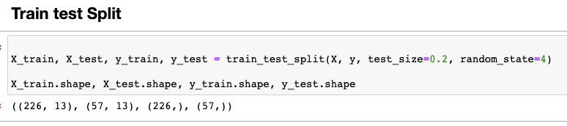
Train Test Split
In this step, we are splitting the data in training and test subsets.
Training set will be used for training the models
Test set will be used for testing and evaluation of the models developed

Slide 20

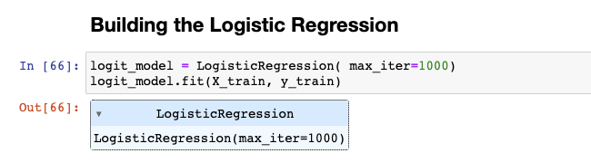
Developing a Model
Logistic Regression is a classification algorithm which works on principle of linearity
We are creating Logistic Regression model and assigning it to logit_model variable
We are training the model using fit function with training data set

Slide 21
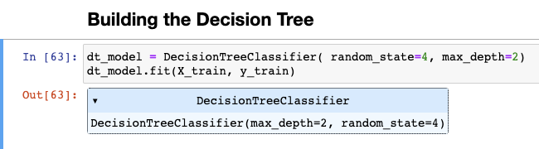
Developing a Model
Decision Tree classifier has been used as a second model in this project. This will work based on tree topology
We are using few configurations like max_depth and random_state
Training the model with training subset

Slide 22

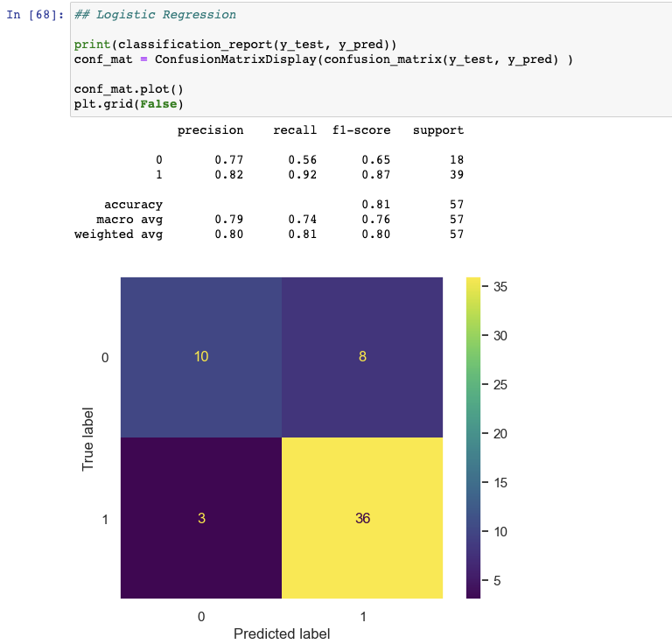
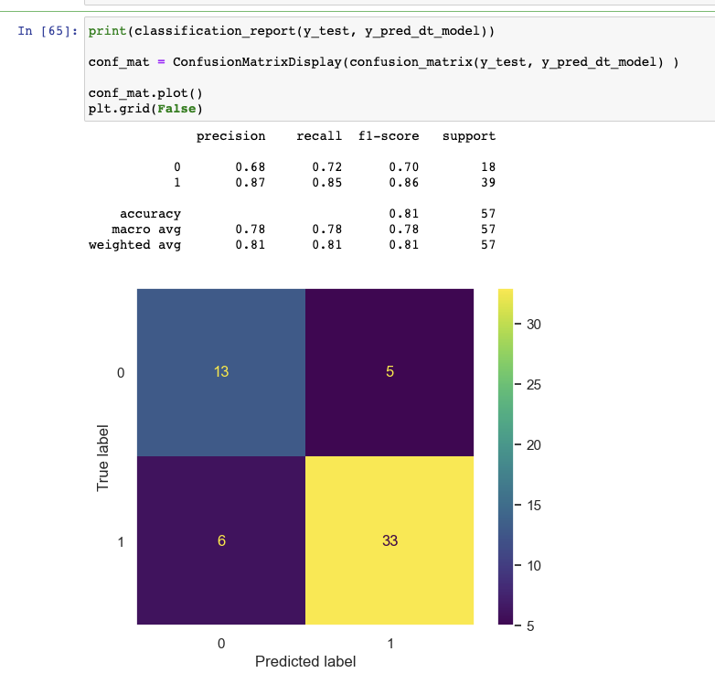
Testing and Evaluation
Logistic Regression Model
Decision Tree Model
We can see classification report of both models.
We can see accuracy, precision, recall scores
We have also plotted confusion matrix for these results

Slide 23

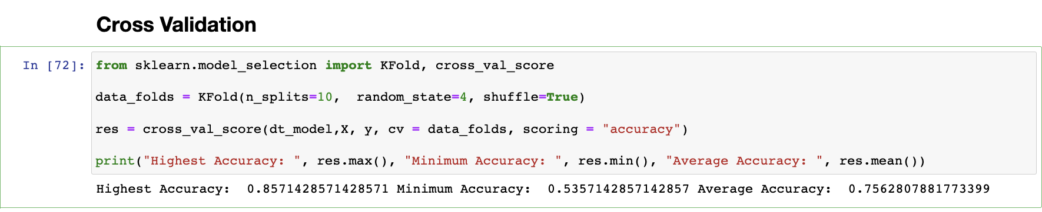
10-Fold Cross Validation
We also done 10-fold cross validation for decision tree model
We have used cross_val_score function of scikit-learn
Cross validation is for finding the highest accuracy that can be achieved using this model for this data

Slide 24
Conclusions
In our predictive analysis, we have taken Logistic Regression and Decision Tree classifier for prediction.
We achieved same Accuracy score of 81% for both models. Which is interesting to see, that both models performed similar for this data even their underlying architecture is different.
We can see precision and recall score are differing though
Cross validation is implemented based on decision tree model using 10 folds of test data.
We could achieve accuracies of maximum at 85.71%, minimum at 53.57% and Average is 75.62%

Slide 25
Team Members

Slide 26
Thank you

